Slide 1
Major Assignment 1
INCOME ANALYSIS, UNIT CONVERSIONS, AND CURRENCY CONVERSIONS

Slide 2
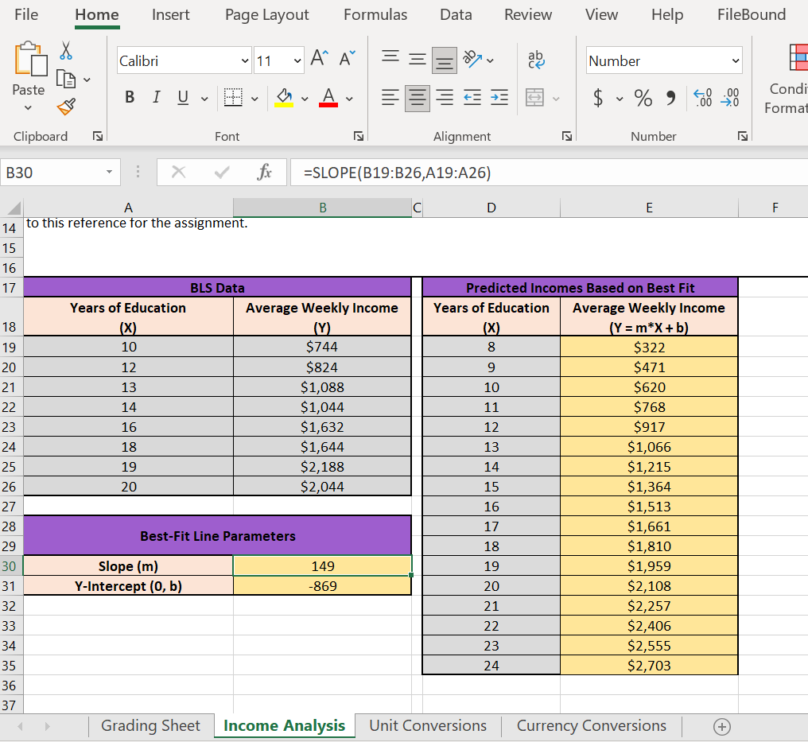
Income Analysis
Enter your name in the blue cell in Part 1.
Find the Best-Fit Line Parameters using the SLOPE() and INTERCEPT() functions.
Slope is explained here: https://support.microsoft.com/en-us/office/slope-function-11fb8f97-3117-4813-98aa-61d7e01276b9
Intercept is explained here: https://support.microsoft.com/en-us/office/intercept-function-2a9b74e2-9d47-4772-b663-3bca70bf63ef
For the Predicted Incomes Based on Best Fit, use the Best-Fit Line Parameters to predict the Average Weekly Incomes for the Years of Education (X) in column D. Follow the slope-intercept form of the line: Y=m*X+b

Slide 3
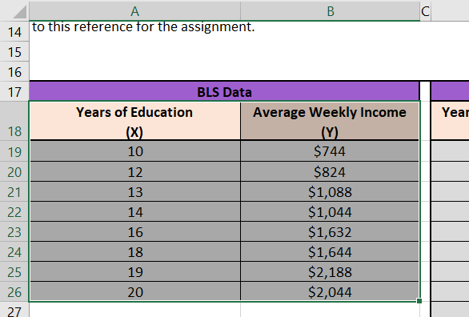
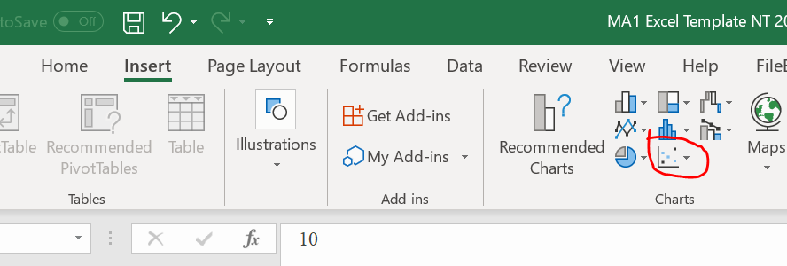
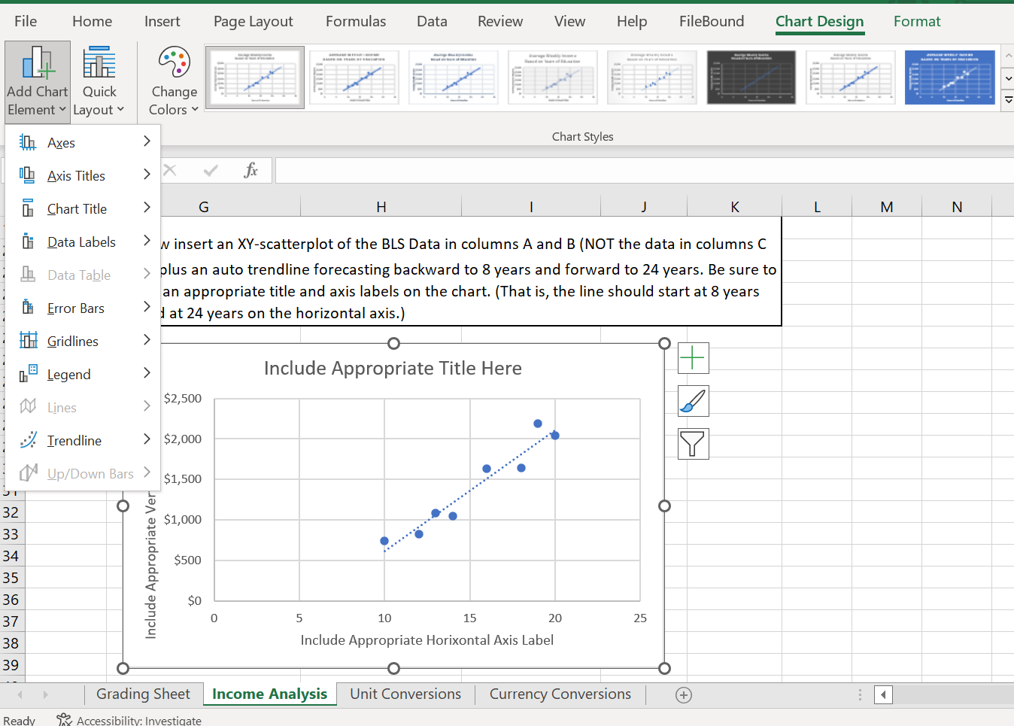
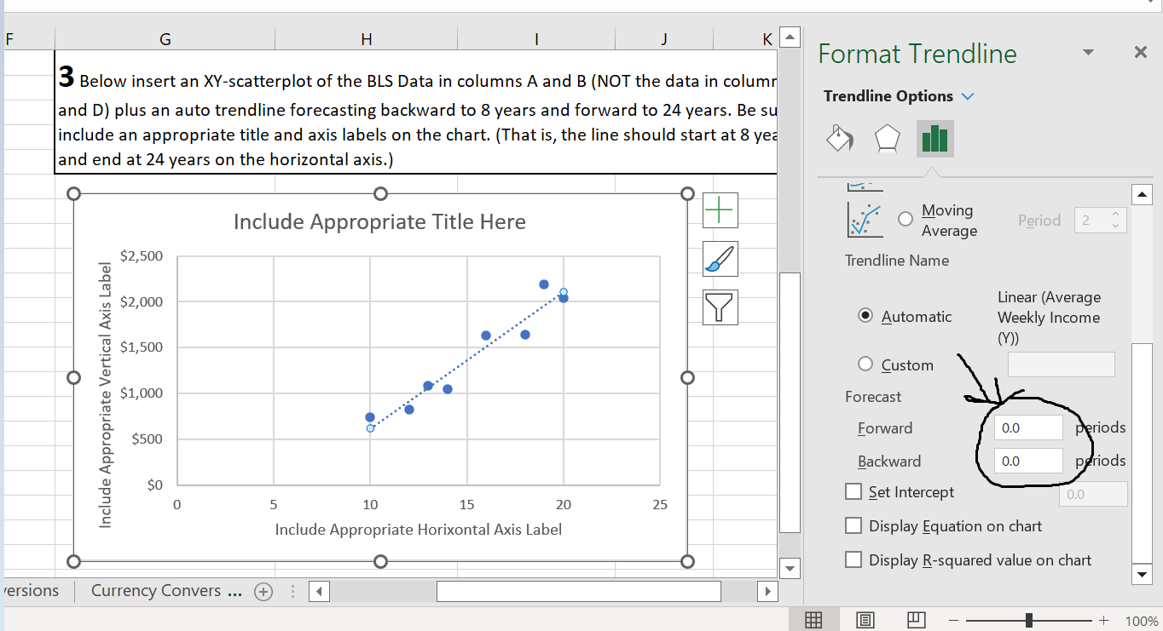
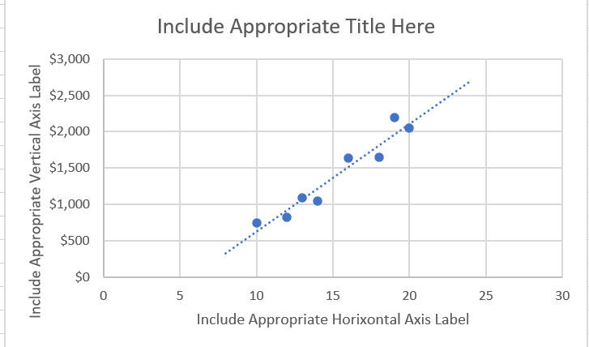
Income Analysis - Scatterplot
Insert a scatterplot modeling the BLS Data from columns A and B.
After the chart is inserted, used the Add Chart Element under Chart Design on your toolbar to include an appropriate title, axis labels, and linear trendline.
Right-click on the trendline and go to Format Trendline… to adjust the forecasting. Forecast the trendline so the line starts at 8 and ends at 24 on the x-axis

Slide 4
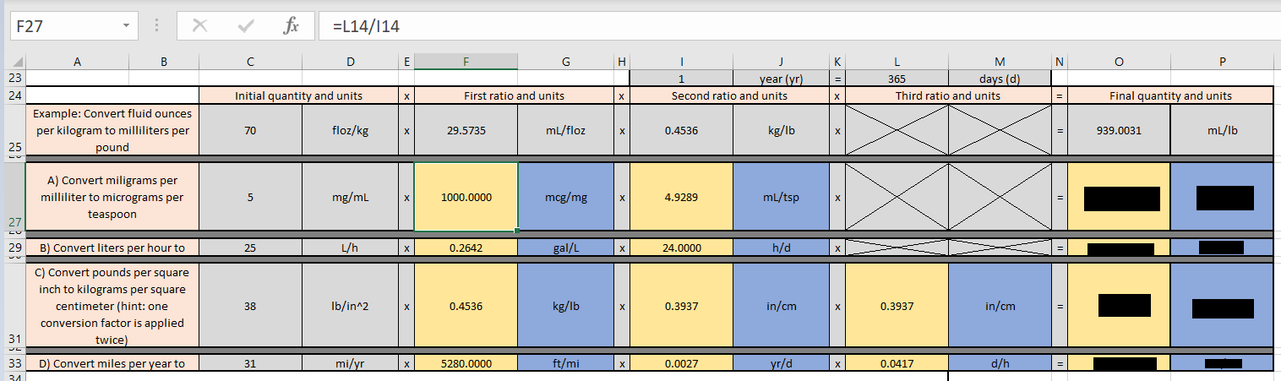
Unit Conversions
Make sure to look for appropriate factors from the Conversion Factor Table.
In yellow cells, you need to enter formulas that reference the conversion factor table above.
In blue cells, you need to enter units as ratios.

Slide 5
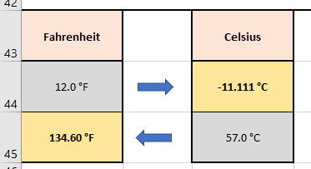
Unit Conversions - Temperatures
Make sure to enter the formulas (Do not use your calculator).
Follow =(5/9)*(F-32) to find the Celsius temperature
Follow =(9/5)*C+32 to find the Fahrenheit temperature

Slide 6
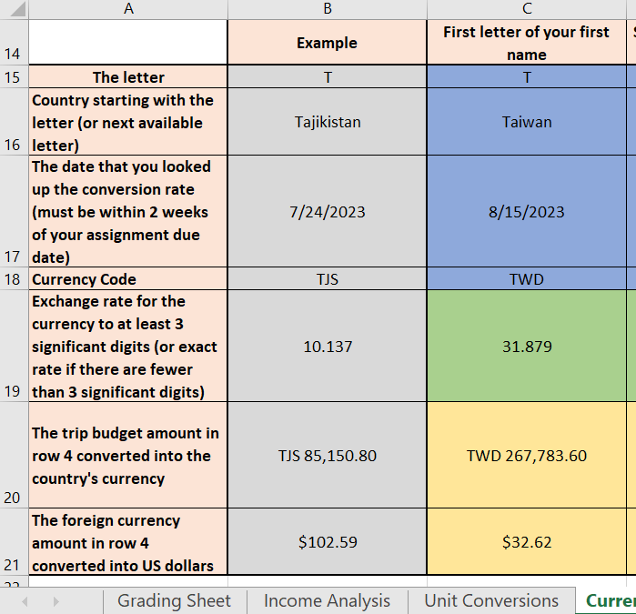
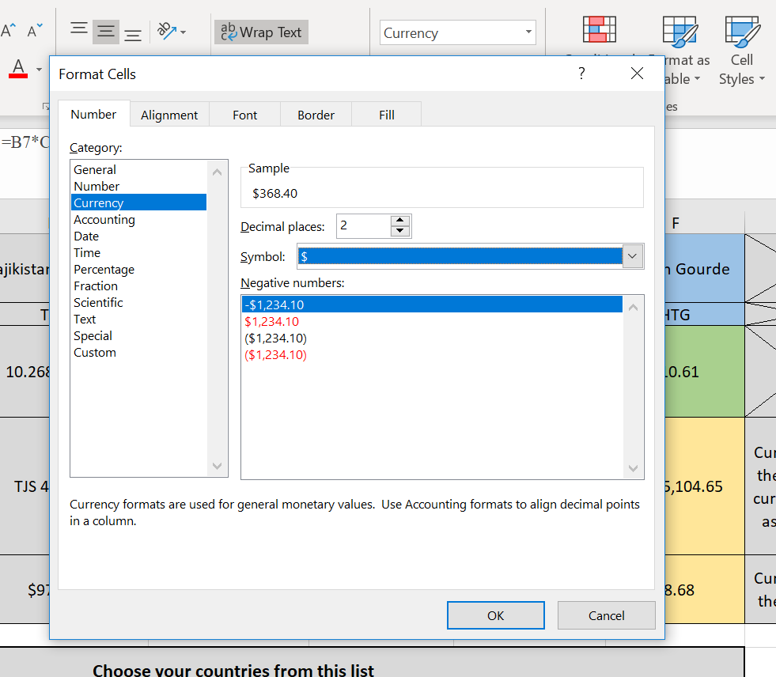
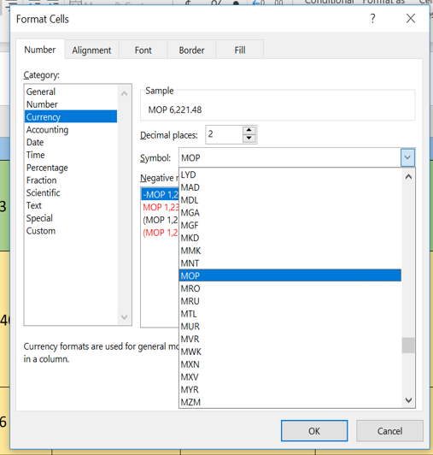
Currency Conversions
Use the Currency Converter website to look up the three-letter currency code and exchange rate for your four countries.
Include the date you looked up the exchange.
Follow this formula to convert the trip budget amount to the country’s currency
=trip budget* Exchange rate with $1.
Format the cells to display the three letter currency code by right-clicking on the cell and going to Format Cells…. Choose Currency as the category and change the Symbol to the three letter code
Follow this formula to convert the foreign currency into US dollars
=foreign currency* (1/Exchange rate with $1).

